Slide 1

Product recognition using computer vision and sensor

Slide 2

Content
Team
Problem & Objective
Questions
ABT
Business Understanding
Communication Channel

Slide 3
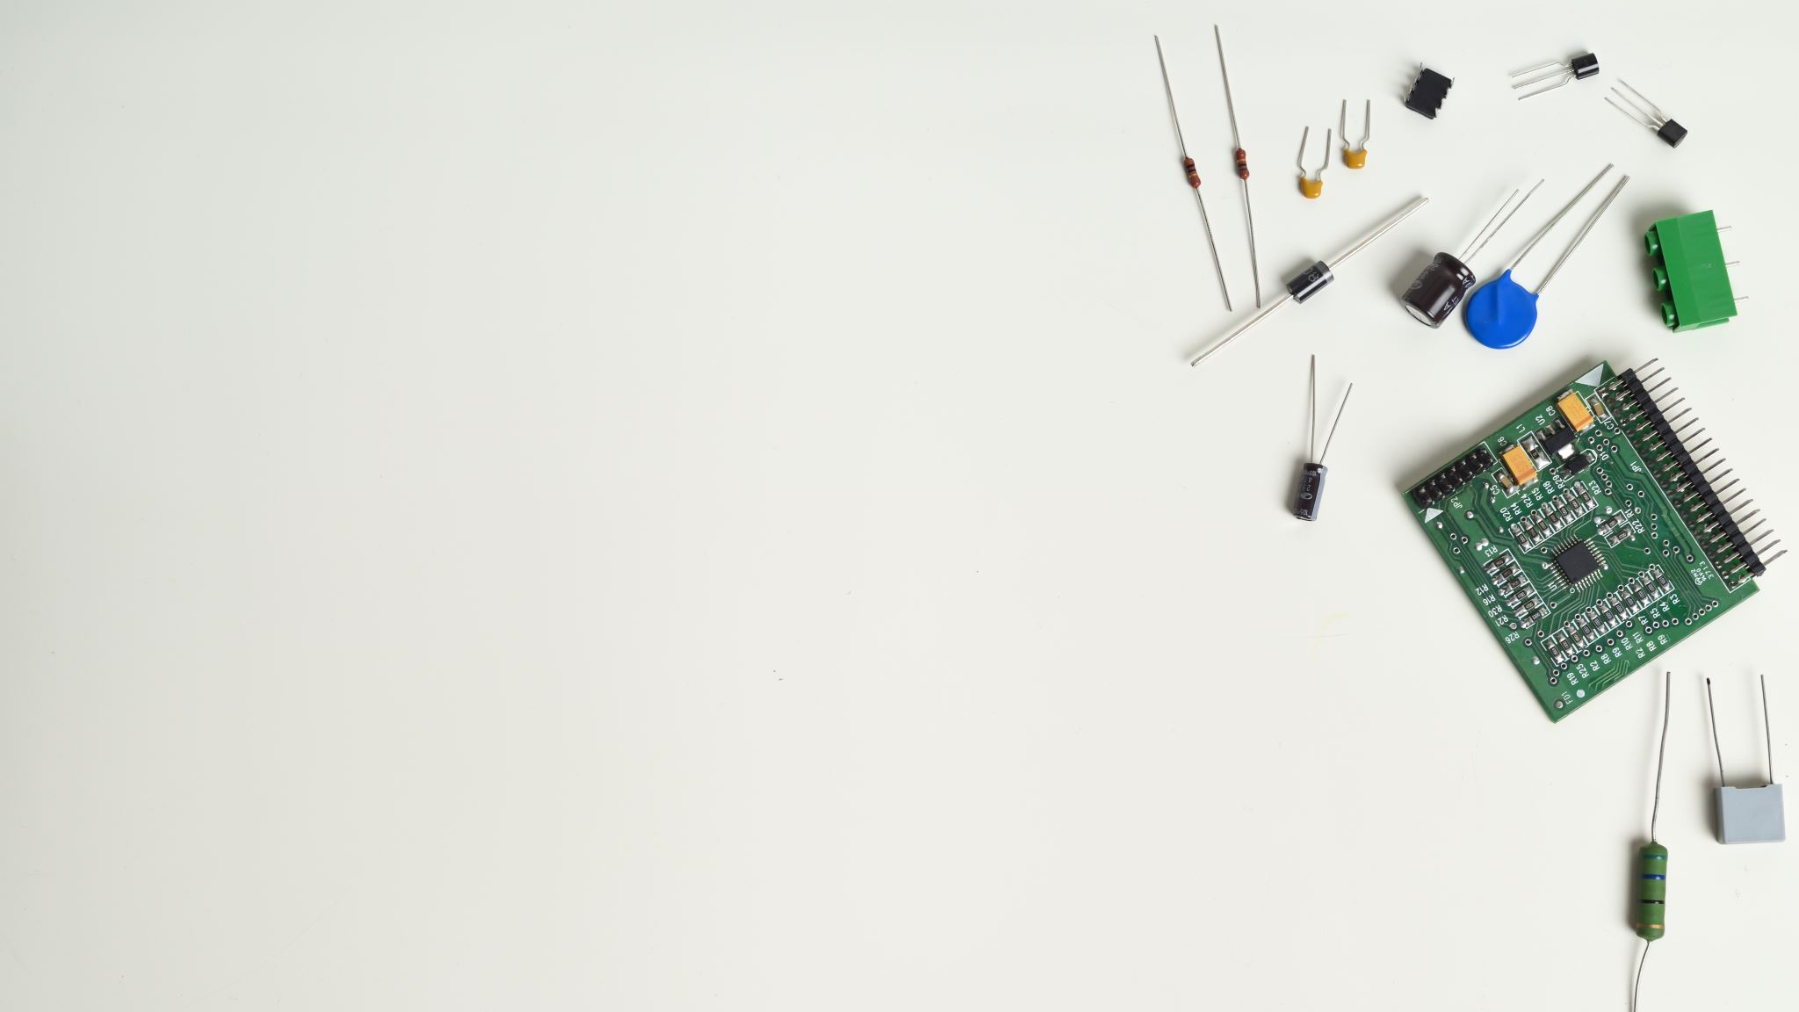
Team
Noufal Babu, MBA in IT & System, Principle Embedded Software Engineer
Ali Boukhari, Master degree in engineering, Data analyst

Slide 4
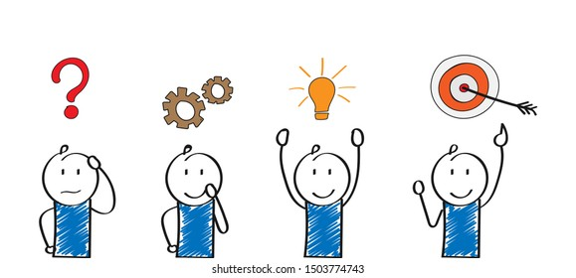
Problem
Our business is currently experiencing delays in the manual product checkout process at the store :-
With the advent of modern shopping experiences, manual checkouts have become a point of friction for customers, causing delays and inefficiencies in our business operations. The traditional checkout process may not only hinder our business growth but also impact customer satisfaction levels.

Slide 5
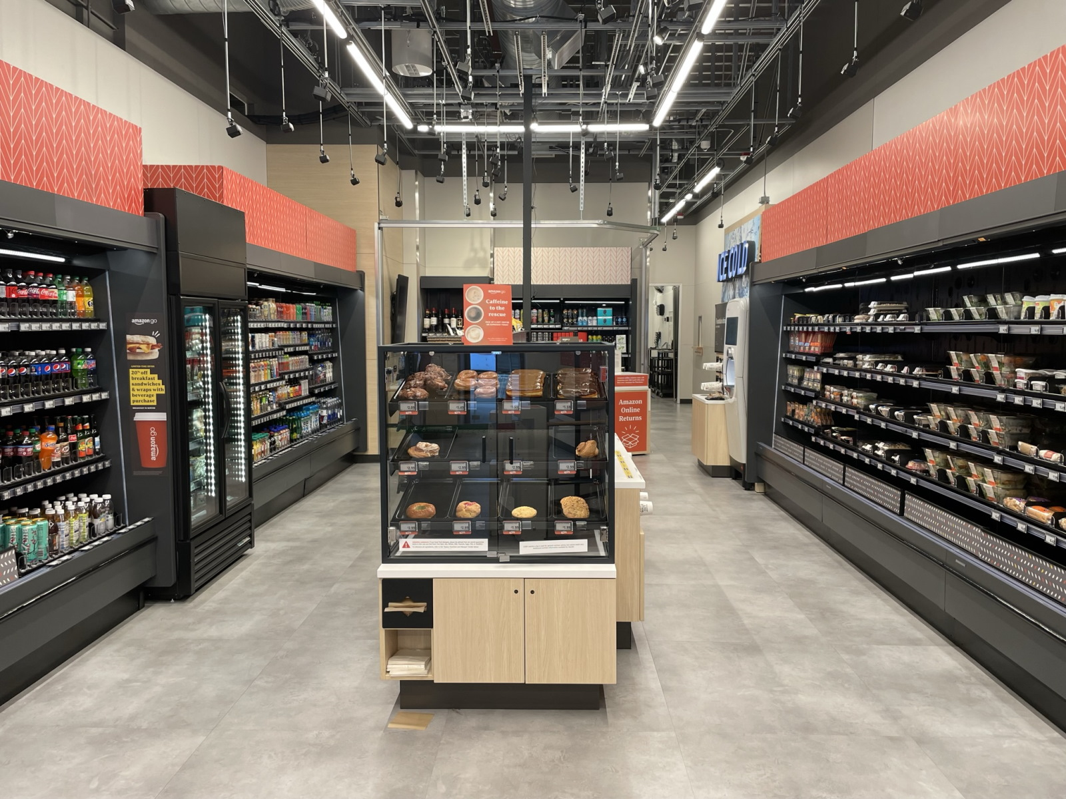
Objective
Our business want to provide shop and go experience to our customers, with customers able to purchase products without being checked out by a cashier or using a self-checkout station

Slide 6
Questions
Descriptive:
Product Interaction Distribution: How are different products interacted with by customers throughout the store? (e.g., Which products are most commonly picked up, added to carts, or returned?)
Predictive:
Product Purchase Likelihood: Based on initial interactions (like picking up a product or examining it for a certain duration), can we predict the likelihood of a customer actually purchasing that product?
Time Analysis: At what times of day or days of the week are interactions (like picking up or returning products) most prevalent in the store?
Customer Behavior Patterns: Are there distinct patterns or sequences in which customers typically interact with products? (e.g., Do they first pick up one category of product before another?)
Customer Checkout Behavior: Can we predict when a customer is about to exit the store and finalize their purchases based on their interactions and time spent in the store?

Slide 7
Analytical Base Table (ABT)
Product
Product Label
Name
Description
Shape
Color
Ingredients
Manufacturer
Size
Weight
Pounds/Kg
Ltr/Milli Litter
Liquid / Solid
Image
Text
Edge

Slide 8
Business understanding
As-is-State :
Checkout Process: Customers manually select items and queue at cashier counters or self-checkout stations.
Customer Experience: Potential for long waiting times, especially during peak hours, leading to dissatisfaction.
To-be-State:-
Checkout Process: Automated "shop and go" experience where customers pick products, and the system automatically recognizes and bills them without manual intervention.
Customer Experience: Swift, seamless, and frictionless shopping experience.
Operational Efficiency: Reduced staff requirement for checkout processes, increased accuracy in billing, and improved inventory tracking.
Operational Efficiency: Requires a significant number of staff for checkout processes and monitoring. Occasional errors in billing or missed items.

Slide 9

Business understanding
Target Variable:
Product Label: Finding the right product label (Coke 500ml, Aquafina Water 1L)
Success Metrics:
Checkout Time Reduction: A 70% decrease in average checkout times compared to the manual process.
Billing Accuracy: The percentage of transactions where the automated system's billing matches the actual products picked by customers.
Customer Satisfaction: Improved ratings or feedback on the shopping experience after the implementation of the system.
Entity:
Products: Items available for purchase in the store.
Customers: Individuals shopping in the store.
Evaluation Metrics:
Model Accuracy: The percentage of correct predictions made by the computer vision model on test data.
System Uptime: The percentage of time the system is operational without glitches or errors.
False Positives/Negatives: The number of incorrect product recognitions or missed interactions.
Feedback Loop: Mechanism for customers to report inaccuracies or provide feedback on their shopping experience.

Slide 10
Communication Channel
Slack
Email
Git
WhatsApp

